Slide 1
CSE523 - Machine Learning Group - 18: The Curators Breast Cancer Detection
Student Name | Student ID
Harsh Patel | AU1940114
Kavan Desai | AU1940126
Sarthak Bharad | AU1940176

Slide 2
Introduction
Breast Cancer begins when healthy cells in the breast undergo change and grow out of control, forming a mass or sheet of cells called a tumor.
A tumor can be malignant (cancerous) or benign.
Breast cancer has currently overtaken lung cancer as the most commonly diagnosed cancer in women worldwide (according to statistics released by the International Agency for Research on Cancer (IARC) in December 2020).

Slide 3
Problem Statement
To predict the state of tumor i.e. malignant or benign based on certain characteristics of the cell using classical machine learning algorithms.

Slide 4
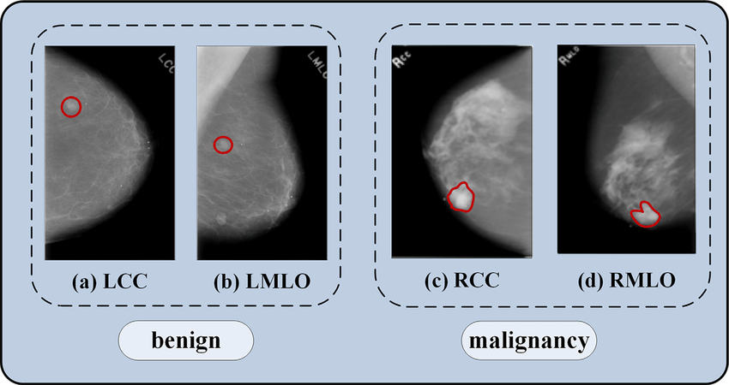
Dataset
The dataset is a preprocessed dataset of images of human cells with certain attributes found from gray scaling the image.
Attribute Information:
1) ID number
2) Diagnosis (M = malignant, B = benign)
Ten real-valued features are computed for each cell nucleus:
a) radius (mean of distances from center to points on the perimeter)
b) texture (standard deviation of gray-scale values)
c) perimeter
d) area
e) smoothness (local variation in radius lengths)
f) compactness (perimeter^2 / area - 1.0)
g) concavity (severity of concave portions of the contour)
h) concave points (number of concave portions of the contour)
i) symmetry
j) fractal dimension ("coastline approximation" - 1)
The mean, standard error and "worst" or largest (mean of the three largest values) of these features were computed for each image, resulting in 30 features. For instance, field 3 is Mean Radius, field 13 is Radius SE, field 23 is Worst Radius.
There are a total of 579 rows and 32 columns all consisting of images due to which the complexity is high.
Benign and malignant mammograms of breast cancer. (a) and (b) are benign, (c) and (d) are malignant, two views are craniocaudal (CC) and mediolateral oblique (MLO), L and R represent left and right, respectively. The red circle shows the location of the breast mass.
Li, Hua & Niu, Jing & Li, Dengao & Zhang, Chen. (2020). Classification of breast mass in two‐view mammograms via deep learning. IET Image Processing. 15. 10.1049/ipr2.12035.

Slide 5
Existing Solutions/Body of Work
There are both model-based and model-free techniques for Breast Cancer Prediction using Machine Learning.
The model-based approaches include:
Generalized Linear Models (GLM)
Logistic Regression (LOGIT)
Linear Discriminant Analysis (LDA)
Quadratic discriminant Analysis (QDA)
Markov Chain Monte Carlo Generalized Linear Mixed Model (MCMC GLMM)
The model-free predictive analytics involve:
Adaptive Boosting Algorithm (ADA)
Random Forest (RF)
k-Nearest Neighbors (KNN)
https://www.sciencedirect.com/science/article/pii/S1877050921014629

Slide 6
Our Approach
texture_worst
compactness_mean
smoothness_worst
Clearing, Merging, EDA…..
concavity_worst
Data Preprocessing
radius_mean
id
Prediction
Training suitable models
Machine Learning Algorithms
Classification
Predicting whether Malignant or Benign
Feature Engineering

Slide 7
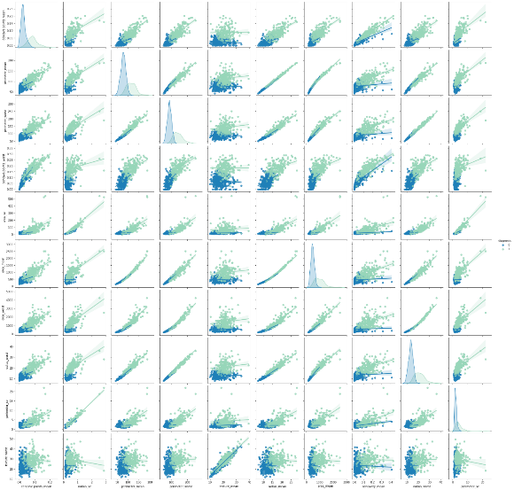
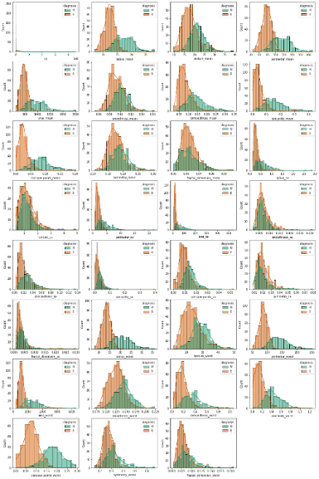
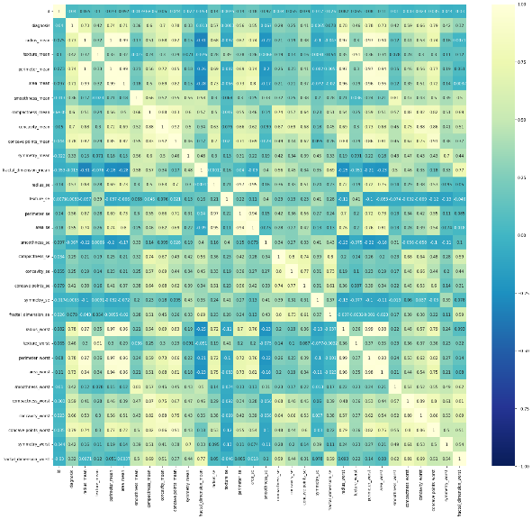
Initial Results
Exploratory Data Analysis (EDA):
The heatmap below shows how the different variables are related to each other and up to what extent.
The correlation above gives dependence between parameters which helps in performing feature engineering
The graph above helps to check which of the parameters are normally distributed and which are skewed distributed.

Slide 8
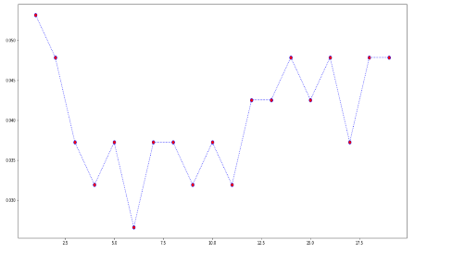
Initial Results
k-Nearest Neighbours:
kNN is used for both classification and regression.
Here we have used kNN as the features of the cell are corelated with each other and the cancerous cell can be classified based on the neighbours.
We used the Euclidean distance in implementation of KNN algorithm.
For the best suitable K, we implemented the mean squared analysis (MSE) over a range of values of K from 1-20.
And as a result, we could conclude that the least error valued K gives approximately 97% accuracy.

Slide 9
Role of Each Member
 | Harsh Patel | Kavan Desai | Sarthak Bharad
EDA | ✔ | ✔
KNN | ✔ | ✔ | ✔
Logistic Regression | ✔ | ✔ | ✔
Data Pre-Processing |  |  | ✔

Slide 10
Future Work
We will perform feature engineering in which we will decide which feature to use if two or more features show similar correlation with diagnostic values, upon applying the afore-mentioned algorithms.
With further feature engineering we aim to improve the performance of our current models.
Further we are planning to implement new algorithms and will try to implement different distance metrics on our current models.

Slide 11
References
UCI Machine Learning Repository: Breast Cancer wisconsin (diagnostic) data set. [Online]. Available: https://archive.ics.uci.edu/ml/datasets/Breast+Cancer+Wisconsin+%28Diagnostic%29. [Accessed: 20-Mar-2022].
“Breast cancer - introduction,” Cancer.Net, 31-Dec-2020. [Online]. Available: https://www.cancer.net/cancer-types/breast-cancer/introduction. [Accessed: 20-Mar-2022].
M. A. Naji, S. E. Filali, K. Aarika, E. L. H. Benlahmar, R. A. Abdelouhahid, and O. Debauche, “Machine learning algorithms for breast cancer prediction and diagnosis,” Procedia Computer Science, 08-Sep-2021. [Online]. Available: https://www.sciencedirect.com/science/article/pii/S1877050921014629. [Accessed: 20-Mar-2022].
Upadhayay, A., 1970. Empirical comparison by data mining classification algorithms ( C 4 . 5 &amp; c 5 . 0 ) for Thyroid Cancer Data Set . Semantic Scholar. Available at: https://www.semanticscholar.org/paper/Empirical-Comparison-by-data-mining-Classification-Upadhayay/6e6d581cf8a96559a91d74274b765b62bde9d4b7 [Accessed March 20, 2022].
R. Turkki, D. Byckhov, M. Lundin, J. Isola, S. Nordling, P. E. Kovanen, C. Verrill, K. von Smitten, H. Joensuu, J. Lundin, and N. Linder, “Breast cancer outcome prediction with tumour tissue images and machine learning,” Breast cancer research and treatment, Aug-2019. [Online]. Available: R. Turkki, D. Byckhov, M. Lundin, J. Isola, S. Nordling, P. E. Kovanen, C. Verrill, K. von Smitten, H. Joensuu, J. Lundin, and N. Linder, “Breast cancer outcome prediction with tumour tissue images and machine learning,” Breast cancer research and treatment, Aug-2019. [Online]. Available: https://www.ncbi.nlm.nih.gov/pmc/articles/PMC6647903/. [Accessed: 20-Mar-2022].. [Accessed: 20-Mar-2022].
M. Montazeri, M. Montazeri, M. Montazeri, and A. Beigzadeh, “Machine learning models in breast cancer survival prediction,” Technology and Health Care, 01-Jan-2016. [Online]. Available: https://content.iospress.com/articles/technology-and-health-care/thc1071. [Accessed: 20-Mar-2022].
Li, Hua & Niu, Jing & Li, Dengao & Zhang, Chen. (2020). Classification of breast mass in two‐view mammograms via deep learning. IET Image Processing. 15. 10.1049/ipr2.12035. https://www.researchgate.net/figure/Benign-and-malignant-mammograms-of-breast-cancer-a-and-b-are-benign-c-and-d-are_fig1_347565521

